Slide 1
Saint Bernard Bus Lines Analysis
Heather aaron | Eric Anderson | Eric chen | Madison clark marissa hall | amethyst ramsey | Alexandra snyder
Notes:
ALL Introduce

Slide 2
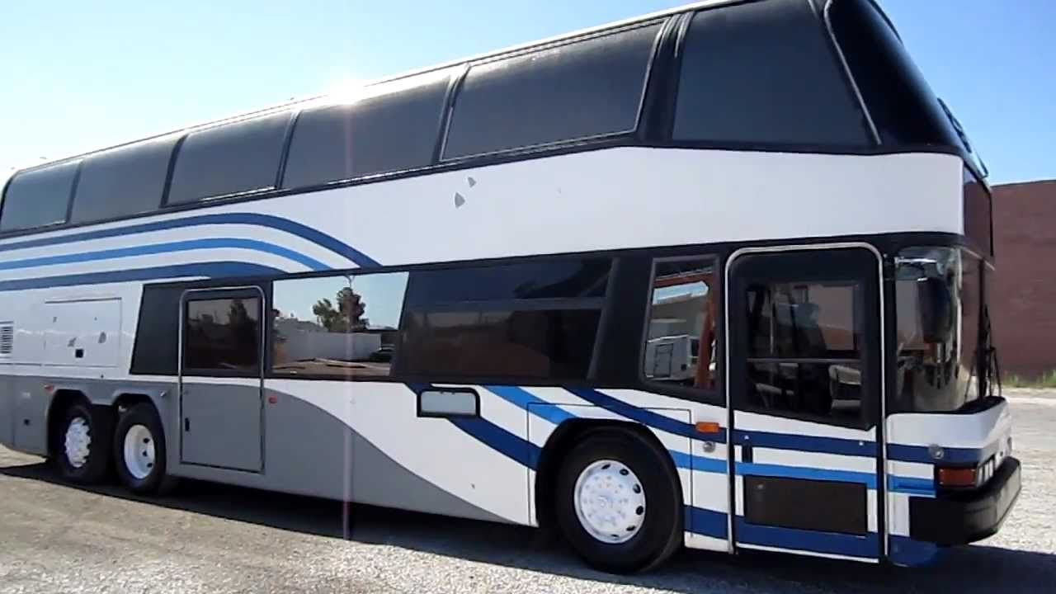
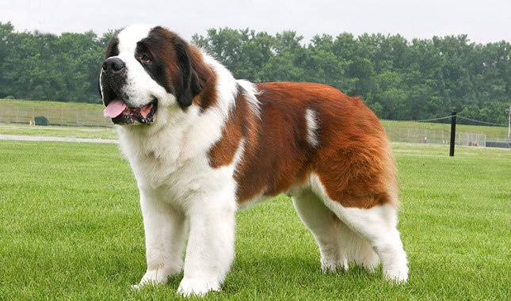
Saint Bernard Training Program
Convenient Philadelphia location
Nationally recognized puppy training
Combine puppy travel with passenger travel to maximize profits
Notes:
Amethyst

Slide 3

Business in the Front, Puppies in the Back
Our unique double-decker buses are designed to house all passengers in the front sections, with all our puppy cargo located in open play sections in the back.
Because of the huge popularity of the Saint Bernard puppy training school, we’ve recognized and filled the need for the puppy transportation to and from the school
Notes:
Eric A.

Slide 4
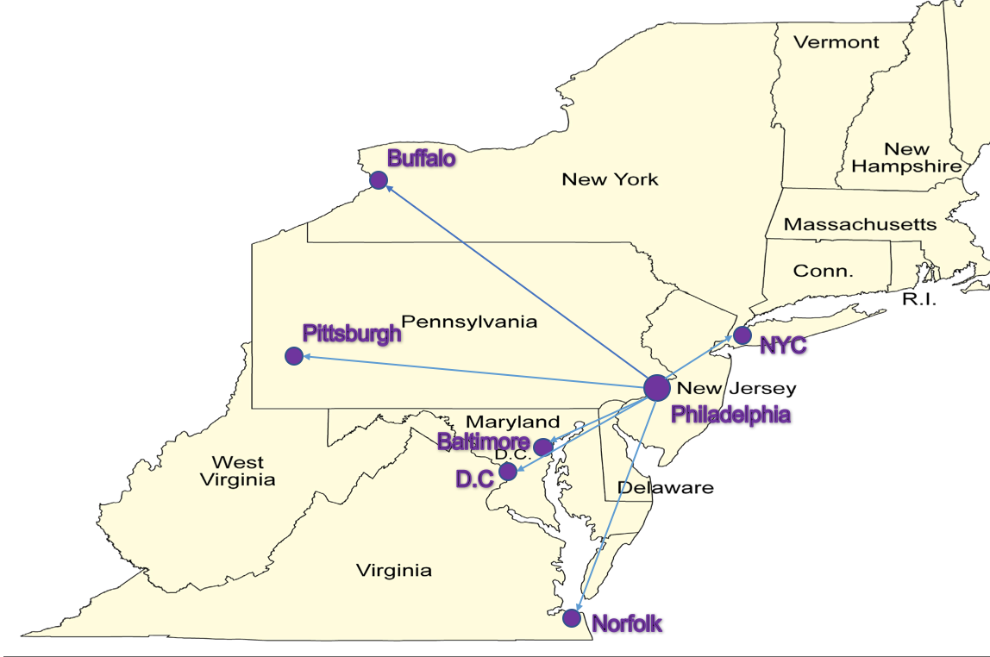
Map of the Travel Route
We travel from Philadelphia to six other Northeastern cities
Notes:
Eric C.

Slide 5
Our Approach to Bussing Puppies and Passengers
Saint Bernard Bus Lines was looking for a new approach to making their bus line more profitable and innovative. We found that there is a St. Bernard training facility that was in need of finding an efficient and easy way to transport their puppies to and from the facility. By combining passenger travel with puppy travel, we aimed to increase the overall profits and success of the Saint Bernard Bus Line.
Notes:
Alexandra

Slide 6
How We Implemented This Plan: We worked to find the perfect balance of passengers and puppies (AKA cargo) to fill the buses. Therefore, we were able to optimize route efficiency and bus capacity for all six routes.
Notes:
Madison

Slide 7
Summary of Our Results
By taking on the puppy cargo, we were able to increase both passenger and cargo revenue which led to higher total revenue.
Because our operating costs stayed stable, our daily gross profit increased significantly with the new revenue from the puppy cargo.
The Excel Solver assisted us in our endeavor by maximizing the arrangement of passengers and puppies allocated to each bus.
Notes:
Marissa

Slide 8
Revenues and Gross Profit Before and After:
Notes:
Heather
With our plan:
As you can see, we made huge increases in the Bus Line’s success and profitability
This bar graph shows that both revenues and gross profit increased

Slide 9
Conclusion
Revenues went up by $68,500
Gross Profit increased by $55,944
- As our data demonstrates, we have been able to increase profitability with a unique and innovative approach.
- The use of the Excel Solver would be helpful to evaluate future progress and profits.
- The only major risk to this approach is if the popularity of Saint Bernard puppies goes down . . . Which from our research, does not look like it will happen any time soon!
Notes:
Alexandra

